Slide 1
Lecture 08
Mechanics of Bitcoin

Slide 2
Recap: Bitcoin consensus
Bitcoin consensus gives us:
Append-only ledger
Decentralized consensus
Miners to validate transactions
assuming a currency exists to motivate miners!
Notes:
But what rules?
Need to clarify what “append-only” means

Slide 3
An account-based ledger
time
Create 25 coins and credit to Alice_{ASSERTED BY MINERS}
Transfer 17 coins from Alice to Bob_{SIGNED(Alice)}
Transfer 8 coins from Bob to Carol_{SIGNED(Bob)}
Transfer 5 coins from Carol to Alice_{SIGNED(Carol)}
Transfer 15 coins from Alice to David_{SIGNED(Alice)}
SIMPLIFICATION: only one transaction per block

Slide 4
An account-based ledger
The downside to this way of doing things is that anyone who wants to determine if a transaction is valid will have to keep track of these account balances.

Slide 5
An account-based ledger (not Bitcoin)
time
might need to scan backwards until genesis!
Create 25 coins and credit to Alice_{ASSERTED BY MINERS}
Transfer 17 coins from Alice to Bob_{SIGNED(Alice)}
Transfer 8 coins from Bob to Carol_{SIGNED(Bob)}
Transfer 5 coins from Carol to Alice_{SIGNED(Carol)}
is this valid?
Transfer 15 coins from Alice to David_{SIGNED(Alice)}
SIMPLIFICATION: only one transaction per block

Slide 6
The bitcoin ledger
Bitcoin uses a ledger that just keeps track of transactions
Transactions specify a number of inputs and outputs
  Inputs are coins being consumed (created in a previous transaction)
  outputs are coins being created.
  Each transaction has a unique identifier. Outputs are indexed beginning with 0, so we will refer to the first output as “output 0”.

Slide 7
A transaction-based ledger (Bitcoin)
Inputs: Ø
Outputs: 25.0→Alice
1
time
we implement this with hash pointers
change address
Inputs: 1[0]
Outputs: 17.0→Bob, 8.0→Alice
SIGNED(Alice)
2
Inputs: 2[0]
Outputs: 8.0→Carol, 9.0→Bob
SIGNED(Bob)
finite scan to check for validity
3
Inputs: 2[1]
Outputs: 6.0→David, 2.0→Alice
SIGNED(Alice)
4
is this valid?
SIMPLIFICATION: only one transaction per block
Notes:
This is called a “change address”

Slide 8
How does it improve verification?
We need to look up the transaction output that Alice referenced,
  it has a value of 25 bitcoins and it hasn’t already been spent.
To ensure it hasn’t been spent,
  we need to scan the block chain between the referenced transaction and the latest block.
  We don’t need to go all the way back to the beginning of the block chain,

Slide 9
Merging value
time
Inputs: ...
Outputs: 17.0→Bob, 8.0→Alice
SIGNED(Alice)
1
...
Inputs: 1[1]
Outputs: 6.0→Carol, 2.0→Bob
SIGNED(Carol)
2
...
Inputs: 1[0], 2[1]
Outputs: 19.0→Bob
SIGNED(Bob)
3
SIMPLIFICATION: only one transaction per block

Slide 10
Joint payments
time
Inputs: ...
Outputs: 17.0→Bob, 8.0→Alice
SIGNED(Alice)
1
...
Inputs: 1[1]
Outputs: 6.0→Carol, 2.0→Bob
SIGNED(Carol)
2
...
Inputs: 2[0], 2[1]
Outputs: 8.0→David
SIGNED(Carol), SIGNED(Bob)
3
two signatures!
SIMPLIFICATION: only one transaction per block

Slide 11
The real deal: a Bitcoin transaction
{
"hash":"5a42590fbe0a90ee8e8747244d6c84f0db1a3a24e8f1b95b10c9e050990b8b6b",
"ver":1,
"vin_sz":2,
"vout_sz":1,
"lock_time":0,
"size":404,
"in":[
{
"prev_out":{
"hash":"3be4ac9728a0823cf5e2deb2e86fc0bd2aa503a91d307b42ba76117d79280260",
"n":0
},
"scriptSig":"30440..."
},
{
"prev_out":{
"hash":"7508e6ab259b4df0fd5147bab0c949d81473db4518f81afc5c3f52f91ff6b34e",
"n":0
},
"scriptSig":"3f3a4ce81...."
}
],
"out":[
{
"value":"10.12287097",
"scriptPubKey":"OP_DUP OP_HASH160 69e02e18b5705a05dd6b28ed517716c894b3d42e OP_EQUALVERIFY OP_CHECKSIG"
}
]
}
metadata
input(s)
output(s)

Slide 12
The real deal: transaction metadata
{
"hash":"5a42590...b8b6b",
"ver":1,
"vin_sz":2,
"vout_sz":1,
"lock_time":0,
"size":404,
...
}
transaction hash
housekeeping
more on this later...
“not valid before”
housekeeping

Slide 13
The real deal: transaction inputs
"in":[
{
"prev_out":{
"hash":"3be4...80260",
"n":0
},
"scriptSig":"30440....3f3a4ce81"
},
...
],`
previous
transaction
signature
(more inputs)

Slide 14
The real deal: transaction outputs
"out":[
{
"value":"10.12287097",
"scriptPubKey":"OP_DUP OP_HASH160 69e...3d42e OP_EQUALVERIFY OP_CHECKSIG"
},
...
]
output value
recipient address??
more on this soon...
(more outputs)

Slide 15
Bitcoin scripts

Slide 16
Output “addresses” are really scripts
Each transaction output doesn’t just specify a public key. It actually specifies a script.
The addresses in bitcoin, the ones used in transactions are hashes of public key!
OP_DUP
OP_HASH160
69e02e18...
OP_EQUALVERIFY OP_CHECKSIG

Slide 17
Output “addresses” are really scripts
We need to check that while redeeming this transaction, the person has the public key that hashes to this address
And we need to check signature as well!
OP_DUP
OP_HASH160
69e02e18...
OP_EQUALVERIFY OP_CHECKSIG

Slide 18
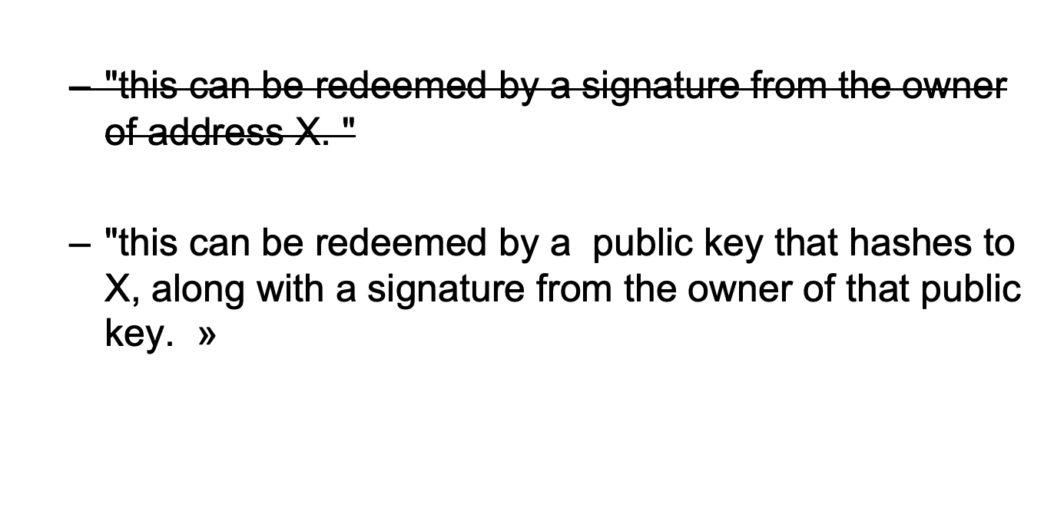
Bitcoin Scripts

Slide 19
Bitcoin scripting logic
To validate that a transaction redeems a previous transaction output correctly,
  we combine the new transaction’s input script and the earlier transaction’s output script.
  We simply concatenate them, and the resulting script must run successfully in order for the transaction to be valid.
  These two scripts are called s​criptPubKey​ and s​criptSig​ because in the simplest case, the output script just specifies a public key (or an address to which the public key hashes), and the input script specifies a signature with that public key.

Slide 20
Input “addresses” are also scripts
30440220...
0467d2c9...
scriptSig
OP_DUP
OP_HASH160
69e02e18...
OP_EQUALVERIFY OP_CHECKSIG
scriptPubKey
TO VERIFY: Concatenated script must execute completely with no errors

Slide 21
Bitcoin Scipts
A stack based programming language, all we’ll need is a stack that we can push data to and pop data from!
There are two types of instructions: data instructions and opcodes.
  When a data instruction appears in a script, that data is simply pushed onto the top of the stack.
  Opcodes, on the other hand, perform some function, often taking as input data that is on top of the stack.

Slide 22
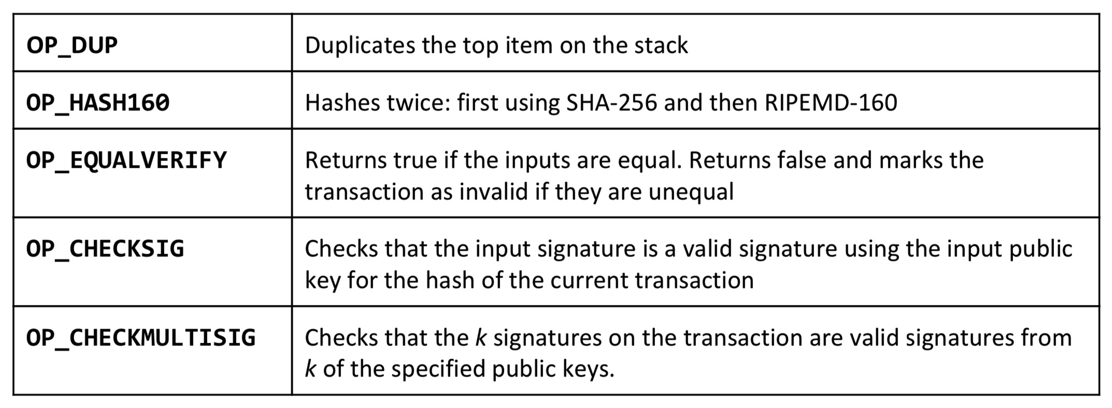
Common Script Instructions

Slide 23
Bitcoin script execution example
✓
<pubKeyHash?>
<pubKey>
<pubKeyHash>
<pubKey>
<sig>
true
<sig> <pubKey> OP_DUP OP_HASH160 <pubKeyHash?> OP_EQUALVERIFY OP_CHECKSIG

Slide 24
Bitcoin scripting language (“Script”)
Design goals
Built for Bitcoin (inspired by Forth)
Simple, compact
Support for cryptography
Stack-based
Limits on time/memory
No looping

Slide 25
Bitcoin script instructions
256 opcodes total (15 disabled, 75 reserved)
Arithmetic
If/then
Logic/data handling
Crypto!
  Hashes
  Signature verification
  Multi-signature verification

Slide 26
Bitcoin scripts in practice
Most nodes whitelist known scripts
99.9% are simple signature checks
~0.01% are MULTISIG
~0.01% are Pay-to-Script-Hash
Remainder are errors, proof-of-burn

Slide 27
Proof-of-burn
nothing’s going to redeem that ☹
OP_RETURN
<arbitrary data>
Notes:
Uses: spam/griefing. Transfer to another cryptocurrency. Fidelity bond

Slide 28
Should senders specify scripts?
?
Big Box
I’m ready to pay for my purchases!
Cool! Well we’re using MULTISIG now, so include a script requiring 2 of our 3 account managers to approve. Don’t get any of those details wrong. Thanks for shopping at Big Box!

Slide 29
Pay to script hash
Big Box
I’m ready to pay for my purchases!
Great! Here’s our address: 0x3454

Slide 30
Applications of Bitcoin scripts

Slide 31

Example 1: Escrow transactions
(normal case)
Pay x to Bob
SIGNED(ALICE, BOB)
Pay x to Alice
SIGNED(ALICE, JUDY)
Judy
To: Alice
From: Bob
(disputed case)
Pay x to 2-of-3 of Alice, Bob, Judy (MULTISIG)
SIGNED(ALICE)
Alice
PROBLEM: Alice wants to buy online from Bob. Alice doesn’t want to pay until after Bob ships.
Bob doesn’t want to ship until after Alice pays.
Bob
Notes:
Gavel from OpenClipArt.com

Slide 32
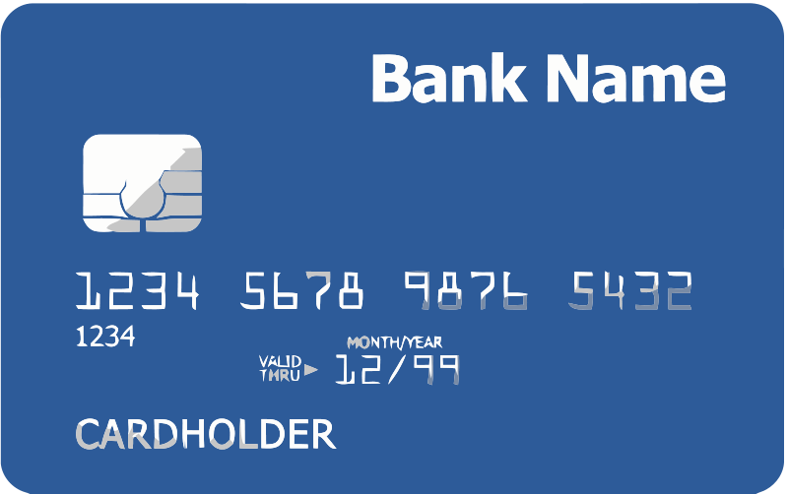

Example 2: Green addresses
004 days since last double spend!
It’s me, Alice! Could you make out a green payment to Bob?
Bank
Pay x to Bob, y to Bank
SIGNED(BANK)
No double spend
Alice
PROBLEM: Alice wants to pay Bob.
Bob can’t wait 6 verifications to guard against double-spends, or is offline completely.
Bob
Notes:
These are mostly dead thanks to Mt. Gox, Instawallet

Slide 33
Example 3: Efficient micro-payments
What if Bob never signs??
Input: x; Pay 42 to Bob, 58 to Alice
SIGNED(ALICE)___________
all of these could be double-spends!
Input: x; Pay 42 to Bob, 58 to Alice
SIGNED(ALICE) SIGNED(BOB)
...
Alice demands a timed refund transaction before starting
Input: x; Pay 04 to Bob, 96 to Alice
SIGNED(ALICE)___________
Input: x; Pay 100 to Alice, LOCK until time t
SIGNED(ALICE) SIGNED(BOB)
I’m done!
I’ll publish!
Input: x; Pay 03 to Bob, 97 to Alice
SIGNED(ALICE)___________
Input: x; Pay 02 to Bob, 98 to Alice
SIGNED(ALICE)___________
Input: x; Pay 01 to Bob, 99 to Alice
SIGNED(ALICE)___________
PROBLEM: Alice wants to pay Bob for each minute of phone service. She doesn’t want to incur a transaction fee every minute.
Bob
Alice
Input: y; Pay 100 to Bob/Alice (MULTISIG)
SIGNED(ALICE)
Notes:
What if Bob never paid?

Slide 34
lock_time
{
"hash":"5a42590...b8b6b",
"ver":1,
"vin_sz":2,
"vout_sz":1,
"lock_time":315415,
"size":404,
...
}
Block index or real-world timestamp before which this transaction can’t be published

Slide 35
Smart Contracts
T​he general term for contracts like the ones we saw in this section is​ s​mart contracts.
These are contracts for which we have some degree of technical enforcement in Bitcoin, whereas traditionally they are enforced through laws or courts of arbitration.

Slide 36
Bitcoin blocks

Slide 37
Bitcoin blocks
Why bundle transactions together?
Single unit of work for miners
Limit length of hash-chain of blocks
  Faster to verify history

Slide 38
Bitcoin block structure
Hash chain of blocks
prev: H( )
prev: H( )
prev: H( )
trans: H( )
trans: H( )
trans: H( )
H( ) H( )
Hash tree (Merkle tree) of transactions in each block
H( ) H( )
H( ) H( )
transaction
transaction
transaction
transaction

Slide 39
The real deal: a Bitcoin block
{
"hash":"00000000000000001aad2...",
"ver":2,
"prev_block":"00000000000000003043...",
"time":1391279636,
"bits":419558700,
"nonce":459459841,
"mrkl_root":"89776...",
"n_tx":354,
"size":181520,
"tx":[
...
],
"mrkl_tree":[
"6bd5eb25...",
...
"89776cdb..."
]
}
block header
transaction data

Slide 40
The real deal: a Bitcoin block header
{
"hash":"00000000000000001aad2...",
"ver":2,
"prev_block":"00000000000000003043...",
"time":1391279636,
"bits":419558700,
"nonce":459459841,
"mrkl_root":"89776...",
...
}
mining puzzle information

Slide 41
The real deal: coinbase transaction
"in":[
{
"prev_out":{
"hash":"000000.....0000000",
"n":4294967295
},
"coinbase":"..."
},
"out":[
{
"value":"25.03371419",
"scriptPubKey":"OPDUP OPHASH160 ... ”
}
redeeming nothing
Null hash pointer
First ever coinbase parameter:
“The Times 03/Jan/2009 Chancellor on brink of second bailout for banks”
arbitrary
block reward
transaction fees

Slide 42
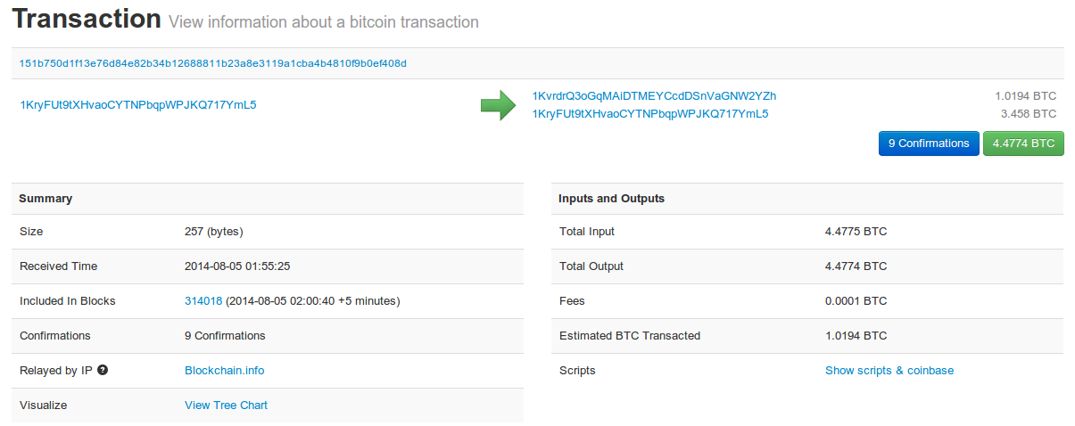
See for yourself!
blockchain.info (and many other sites)

Slide 43
The Bitcoin network

Slide 44
Bitcoin P2P network
Ad-hoc protocol (runs on TCP port 8333)
Ad-hoc network with random topology
All nodes are equal
New nodes can join at any time
Forget non-responding nodes after 3 hr

Slide 45
Joining the Bitcoin P2P network
5
1
Hello World! I’m ready to Bitcoin!
7
8
getaddr()
getaddr()
1, 7
getaddr()
3
6
2
4
Notes:
No geographic topology
Seed nodes
No formal way of leaving

Slide 46
Transaction propagation (flooding)
Already heard that!
5
1
7
8
A→B
A→B
A→B
New tx!
A→B
3
6
A→B
2
A→B
A→B
A→B
4
A→B
A→B
A→B
Notes:
Transactions are propagated in the “pending transaction pool”

Slide 47
Should I relay a proposed transaction?
Transaction valid with current block chain
(default) script matches a whitelist
  Avoid unusual scripts
Haven’t seen before
  Avoid infinite loops
Doesn’t conflict with others I’ve relayed
  Avoid double-spends
Sanity checks only...
Some nodes may ignore them!

Slide 48
Nodes may differ on transaction pool
New` tx!
A→C
5
1
A→C
A→B
A→C
7
A→C
A→C
8
A→C
A→B
A→B
A→B
3
6
2
A→B
A→B
A→B
4
A→B

Slide 49
Race conditions
Transactions or blocks may conflict
Default behavior: accept what you hear first
Network position matters
Miners may implement other logic!

Slide 50
Block propagation nearly identical
Relay a new block when you hear it if:
Block meets the hash target
Block has all valid transactions
  Run all scripts, even if you wouldn’t relay
Block builds on current longest chain
  Avoid forks
Sanity check
Also may be ignored...

Slide 51
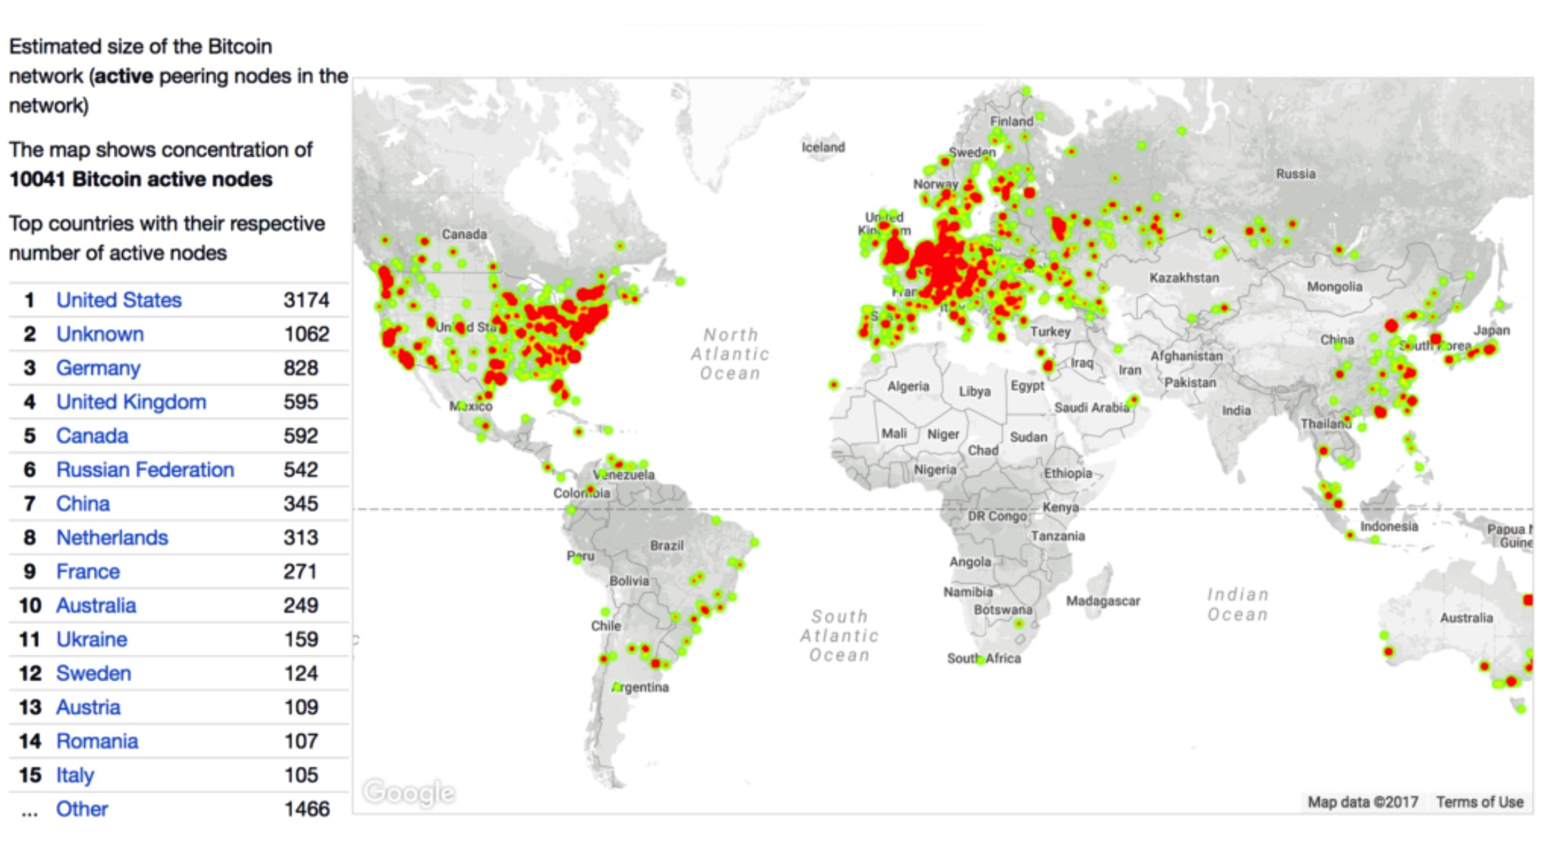
How big is the network?

Slide 52
Fully-validating nodes
Permanently connected
Store entire block chain
Hear and forward every node/transaction

Slide 53
Storage costs

Slide 54
Thin/SPV clients (not fully-validating)
Idea: don’t store everything
Store block headers only
Request transactions as needed
  To verify incoming payment
Trust fully-validating nodes
1000x cost savings! (20 GB-23MB)
Notes:
Also called “lightweight nodes”

Slide 55
Limitations & improvements

Slide 56
Hard-coded limits in Bitcoin
10 min. average creation time per block
1 M bytes in a block
20,000 signature operations per block
100 M satoshis per bitcoin
21M total bitcoins maximum
50,25,12.5... bitcoin mining reward

Slide 57
Throughput limits in Bitcoin
1 M bytes/block (10 min)
>250 bytes/transaction
7 transactions/sec ☹
Compare to:
VISA: 2,000-10,000 transactions/sec
PayPal: 50-100 transaction/sec

Slide 58
Cryptographic limits in Bitcoin
Only 1 signature algorithm (ECDSA/P256)
Hard-coded hash functions
Crypto primitives might break by 2040...

Slide 59
“Hard-forking” changes to Bitcoin
5
1
Block 24
Block 23
Block 23
7
8
Block 24
That’s crazy talk!!
Block 23
That’s crazy talk!!
Block 24
Block 23
24
I found a nifty new block!
3
6
24
2
Block 23
Block 24
Block 23
Block 23
24
4
24
Block 24
PROBLEM: Old nodes will never catch up
Block 23

Slide 60
Soft forks
Observation: we can add new features which only limit the set of valid transactions
Need majority of nodes to enforce new rules
Old nodes will approve
RISK: Old nodes might mine now-invalid blocks

Slide 61
Hard forks
New op codes
Changes to size limits
Changes to mining rate
Many small bug fixes
Currently seem very unlikely to happen

Slide 62
Do not distribute ...
These slides are not always prepared by me.
Most of the content comes from the reference book
  Bitcoin and Cryptocurrency Technologies: A Comprehensive Introduction
  Arvind Narayanan, Joseph Bonneau,
  Edward Felten, Andrew Miller, Steven Goldfeder

